Slide 1
Chapter 1: Intro to I-O Psychology
Psychology 345:
Workplace Psychology

Slide 2
Industrial-Organizational Psychology
What is it?
Why study the workplace?
What’s my story?
Notes:
Psychology is the science of human behavior
I/O psychology is the science of human behavior at work
Dual focus
Efficiency/productivity of organizations (I)
Health/well-being of employees (O)
Dual nature
Development and application of the science of psychology to the workplace
It is a science! This isn’t a business course!

Slide 3
What Is I/O Psychology?
A branch of psychology that applies the principles of psychology to the workplace (Aamodt, 2023)
Industrial-organizational psychologists are able to apply psychological theories to explain and enhance the effectiveness of human behavior in the workplace (Canadian Psychological Association)
I/O psychologists “enhance the dignity and performance of human beings, and the organizations they work in, by advancing the science and knowledge of human behavior” (Rucci, 2008)

Slide 4










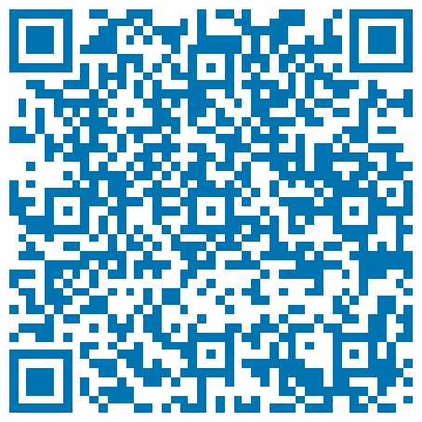
Head of People Analytics
Quinn Knudsen
~ 4 Years
Years at BASF:
Current Role in BASF
Additional Information:
Building a data-informed culture via thought leadership around trust, coaching, transparency and upskilling
Subject Matter Expertise
Hiking/Being active
Traveling
Learning
Underwhelming humor
NY sports (tears occasional)
Adjunct Professor of Workplace Psychology
People analytics conference panelist and guest speaker
Psychological research & design, assessment & measurement, leadership development, organizational interventions, survey & scale development
Specialization
Statistics & Machine Learning, Survey Design, ROI Measurement & KPI Development
Education:
Special Analytic Project Work
B.A. Ramapo College- Clinical Psychology
M.A. Montclair State university- industrial organizational psychology
M.S. Syracuse University - Applied Data Science
Ad hoc analytic consulting, KPI measurement design, enterprise enablement, coaching/teaching, change management
Community Development
President & founder of global analytic community: Stat Pack
Co-founder of HR Analytics Exchange community
Argyle HR Advisory Board Member
Data Analysis Toolkit
Excel, SPSS, R, Python, SQL, Minitab, Tableau, PowerBI
Florham Park, New Jersey
topics of interest
Meaningfulness of Work, Leadership Development, Organizational Intervention Impact
“I challenge the present to build a better future.”

Slide 5
Employment of I/O Psychologists
Employment Setting | Highest Degree Obtained (M.A.) | Highest Degree Obtained (Ph.D.)
Education | 3% | 45%
Private sector | 76% | 43%
Public sector | 8% | 7%
Nonprofit | 12% | 6%
Source: SIOP (2020).

Slide 6
Educational Requirements
Graduate Record Exam (GRE)
Types of Graduate Programs
Master’s programs
Doctoral programs

Slide 7
I/O Graduate Programs
Characteristic | Degree: M.A. | Degree: Ph.D.
Average GPA | 3.41 | 3.58
Years to complete | 2 | 5
Internship | Yes | Yes
Dissertation | No | Yes
Notes:
GPA and GRE averages are taken from the data in Appendix A and Appendix B

Slide 8
Industrial-Organizational Psychology
M.A. | $80,750
Ph.D. | $113,200
Notes:
Median Salaries of I-O Psychologists in the US in 2012 (SIOP Salary Survey)
FYI: location numbers are based on PhDs only and small sample sizes
Type of job is only based on PhDs

Slide 9
Industrial-Organizational Psychology
M.A. | $80,750
Ph.D. | $113,200
Applied – Self Employed | $196,051
Applied – Consulting Firm | $129,496
Academic | $104,000
Notes:
Median Salaries of I-O Psychologists in the US in 2012 (SIOP Salary Survey)
FYI: location numbers are based on PhDs only and small sample sizes
Type of job is only based on PhDs

Slide 10
Industrial-Organizational Psychology
M.A. | $80,750
Ph.D. | $113,200
Applied – Self Employed | $196,051
Applied – Consulting Firm | $129,496
Academic | $104,000
NYC | $223,239
Greater NYC Area | $167,081
Notes:
Median Salaries of I-O Psychologists in the US in 2012 (SIOP Salary Survey)
FYI: location numbers are based on PhDs only and small sample sizes
Type of job is only based on PhDs

Slide 11
Industrial-Organizational Psychology
M.A. | $80,750
Ph.D. | $113,200
Applied – Self Employed | $196,051
Applied – Consulting Firm | $129,496
Academic | $104,000
NYC | $223,239
Greater NYC Area | $167,081
M.A. Starting Salary | $65,521
Ph.D. Starting Salary | $81,815
Notes:
Median Salaries of I-O Psychologists in the US in 2012 (SIOP Salary Survey)
FYI: location numbers are based on PhDs only and small sample sizes
Type of job is only based on PhDs

Slide 12
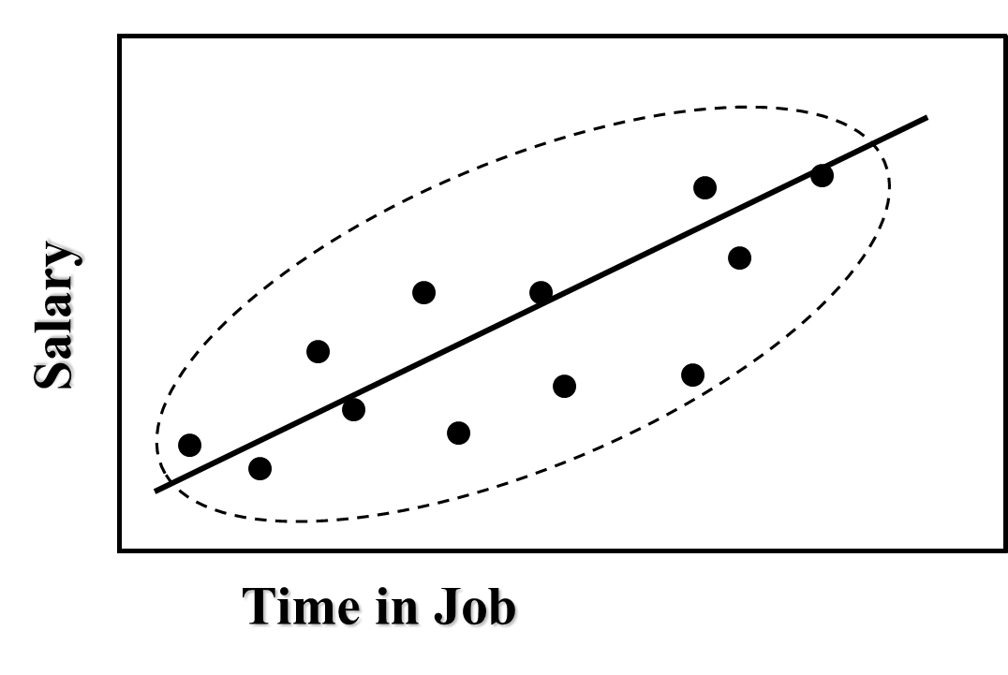
Correlation of 0.50

Slide 13
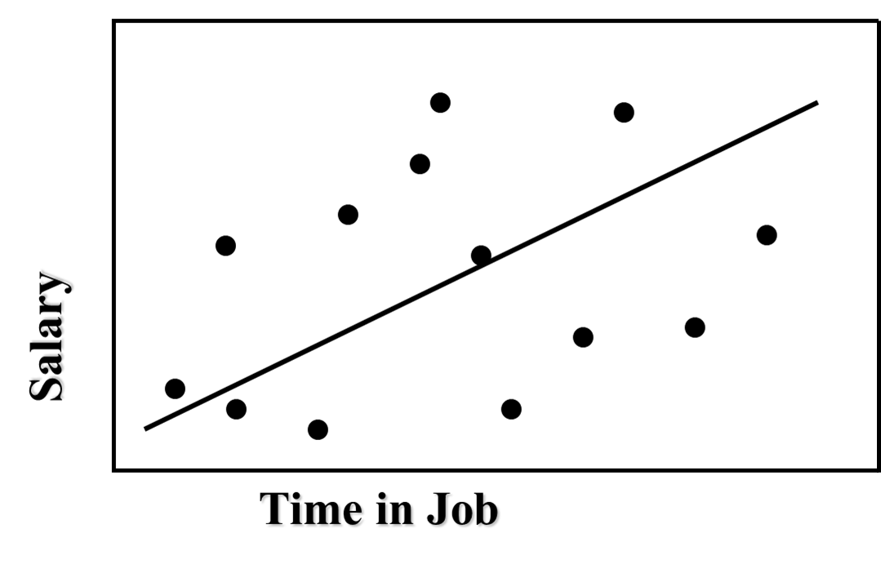
Correlation of 0.20

Slide 14
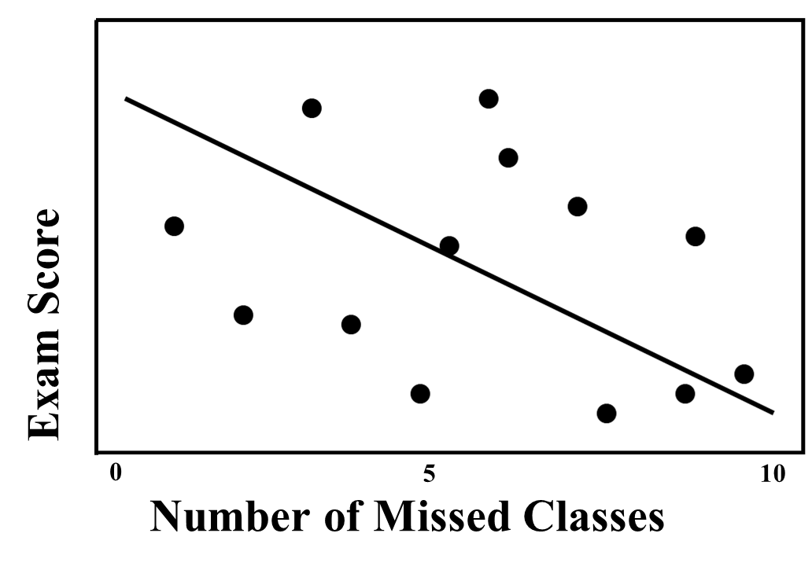
Correlation of -0.20

Slide 15

Industrial/Organizational Psychology: An Applied Approach, 9e
Chapter 1: Introduction to I/O Psychology
Michael G. Aamodt, Industrial/Organizational Psychology: An Applied Approach, 9th Edition. © 2023 Cengage. All Rights Reserved. May not be scanned, copied or duplicated, or posted to a publicly accessible website, in whole or in part.

Slide 16
Icebreaker: Interview Simulation
Break into pairs of students.
Interview each other to find out: 1) one interesting or unusual fact about your partner, and 2) why your partner is taking this class.
Think about connecting a story from your personal experience to topics that are relevant to this course.
Introduce one another to the class.

Slide 17
Learning Objectives
By the end of this chapter, you should be able to:
01-01 Define I/O psychology
01-02 Describe what I/O psychologists do
01-03 Summarize the history of I/O psychology
01-04 List the admissions requirements for graduate programs in I/O psychology
01-05 Explain the importance of conducting research
01-06 Describe how to evaluate I/O psychology research
01-07 Differentiate various research methods

Slide 18
The Field of I/O Psychology

Slide 19
Differences Between I/O and Business Programs
Typical I/O Courses | Typical MBA Courses
Research methods | Finance
Quantitative methods | Marketing
Employee selection | Corporate strategies and policies
Organizational psychology/behavior | Accounting
Psychometrics/test construction | Information systems
Training & development | Economics
Performance appraisal | Operations management
Ethics | Culture/global/international business
 | Ethics
Source: Moberg & Moore (2011)

Slide 20
Fields of I/O Psychology
Personnel Psychology
Organizational Psychology
Human Factors/Ergonomics

Slide 21
Brief History of I/O Psychology 1900–1920
1903 | Walter Dill Scott publishes The Theory of Advertising
1911 | Walter Dill Scott publishes Increasing Human Efficiency in Business Frederick Winslow Taylor publishes The Principles of Scientific Management
1913 | Hugo Munsterberg publishes Psychology and Industrial Efficiency
1917 | Journal of Applied Psychology first published
1918 | WWI provides I/O psychologists with first opportunity for large-scale employee testing and selection

Slide 22
Brief History of I/O Psychology 1920-1940
1921 | First Ph.D. in I/O Psychology awarded to Bruce Moore and Merrill Ream at Carnegie Tech
1932 | First I/O text written by Morris Viteles
1933 | Hawthorne studies published
1937 | American Association for Applied Psychology established
1939 | The Dictionary of Occupational Titles (DOT) was first published by the U.S. Employment Service

Slide 23
Brief History of I/O Psychology 1940-1960
1945 | Society for Industrial and Business Psychology established as Division 14 of the APA with 130 members
1951 | Marion Bills elected as first woman president of Division 14
1960 | Division 14 renamed as Society for Industrial Psychology, membership exceeds 700

Slide 24
Brief History of I/O Psychology 1960-1980
1963 | Equal Pay Act passed
1964 | Civil Rights Act passed First issue of The Industrial-Organizational Psychologist published
1970 | Division 14 membership exceeds 1,100
1971 | B.F. Skinner publishes Beyond Freedom and Dignity
1980 | Division 14 membership exceeds 1,800

Slide 25
Brief History of I/O Psychology 1980-2000
1982 | Division 14 renamed Society for Industrial and Organizational Psychology (SIOP)
1986 | SIOP holds first annual national conference separate from APA meeting
1989 | Supreme Court sets conservative trend and becomes more “employer friendly”
1990 | Americans with Disabilities Act passed SIOP membership exceeds 2,800
1991 | Civil Rights Act of 1991 passed to overcome 1989 conservative Supreme Court decisions
1997 | SIOP celebrates golden anniversary at its annual conference in St. Louis
2000 | SIOP membership exceeds 5,700

Slide 26
Brief History of I/O Psychology 2000-2020
2005 | Office of Federal Contract Compliance Programs (OFCCP) and Equal Employment Opportunity Commission (EEOC) become more aggressive in fighting systematic discrimination
2008 | The journal Industrial and Organizational Psychology: Perspectives on Science and Practice begins publication as an official journal of SIOP
2009 | Lily Ledbetter Fair Pay Act and Americans with Disabilities Act Amendment Act (ADAAA) passed
2010 | SIOP membership exceeds 8,000
2013 | OFCCP issues new regulations affecting the hiring of military veterans and individuals with disabilities
2020 | SIOP membership exceeds 7,500

Slide 27
Research in I/O Psychology

Slide 28
Why Conduct Research?
Answering questions and making decisions
Research and everyday life
Common sense is often wrong

Slide 29
Considerations in Conducting Research
Ideas
Hypotheses - an educated prediction about the answer to a question
Theories - systematic sets of assumptions regarding the nature and cause of particular events

Slide 30
Hypothesis Example 1
Does all this noise affect my employees’ performance? | High levels of noise will increase the number of errors made in assembling electronic components. | Noise causes a distraction, making it difficult to concentrate.
Idea or question | Hypothesis or prediction | Theory or explanation
 | What will happen | Why it will happen

Slide 31
Hypothesis Example 2
What employee recruitment source is best? | Employee referrals will result in employees who stay with the company longer than will the other recruitment methods. | 1. Realistic job preview theory 2. Differential recruitment-source theory 3. Personality similarity theory 4. Socialization theory
Idea or question | Hypothesis or prediction | Theory or explanation
 | What will happen | Why it will happen

Slide 32
Literature Reviews
Written sources
Journals
Bridge publications
Trade magazines
Magazines
Internet (word of caution)

Slide 33
The Location of the Study
Locations
Laboratory research
Field research
Issues
Informed consent
Institutional review boards

Slide 34
The Research Method to Be Used
Experiments
Independent variable is manipulated {and}
Subjects are randomly assigned to conditions
Measure changes in the dependent variable
Quasi-experiments
Independent variable is not manipulated {or}
Subjects are not randomly assigned to conditions
Archival research
Surveys
Meta-analysis

Slide 35
Independent and Dependent Variables
Independent Variable
Experimental group
Control group
Dependent Variable

Slide 36
Experimental Design Example 1
A researcher thinks that average customer sales per employee will increase if an employee has received customer-service training (conducted in September)
Independent variable = customer-service training received
Dependent variable = average customer sales per employee
Average customer sales per employee
Received training in September | August | October | Change
Yes | $3,200 | $4,700 | $1,500
No | $3,100 | $3,500 | $400

Slide 37
Experimental Design Example 2
A researcher thinks that setting goals will increase the number of orders that are “upsized” at McBurger King
Independent variable = Setting of goals (yes or no)
Dependent variable = # of upsized orders
Experimental Condition
 | No Goals | Goals
# of upsized orders | 18 | 79

Slide 38
Activity 1: Knowledge-Check Questions
Identify the independent and dependent variables:
Are employees in large organizations more likely to miss work than those in small organizations?
Will taking a practice test increase scores on an employment test?
Will making “to do” lists decrease the stress of managers?

Slide 39
Activity 1: Knowledge-Check Questions (cont.)
Identify the independent and dependent variables:
A researcher found that employees with customer service training have fewer customer complaints than employees who haven’t been trained.
A researcher found that employees on the night shift make more errors than those on the day shift.
A researcher found that employees paid on commission were more productive but less satisfied than employees paid an hourly rate.

Slide 40
Activity 1: Knowledge-Check Answers
Identify the independent and dependent variables:
Are employees in large organizations more likely to miss work than those in small organizations? (IV: organization size, DV: work missed)
Will taking a practice test increase scores on an employment test? (IV: practice test, DV: employment test scores)
Will making “to do” lists decrease the stress of managers? (IV: “to do” lists, DV: manager stress)

Slide 41
Activity 1: Knowledge-Check Answers (cont.)
Identify the independent and dependent variables:
A researcher found that employees with customer service training have fewer customer complaints than employees who haven’t been trained. (IV: customer service training, DV: customer complaints)
A researcher found that employees on the night shift make more errors than those on the day shift. (IV: time of shift, DV: errors made)
A researcher found that employees paid on commission were more productive but less satisfied than employees paid an hourly rate. (IV: commission or hourly rate, DV: productivity, satisfaction)

Slide 42
Quasi-Experiments
Used when experiments are not practical or when manipulating a variable may not be ethical
A study is a quasi-experiment rather than an experiment when
The independent variable is not manipulated {or}
Subjects are not randomly assigned to conditions
Cannot determine cause-effect relationships

Slide 43
Example: The Child-Care Center
2021 Employee absenteeism average rate = 5.09%
2022 On-site child-care center established (Jan 1)
2022 Employee absenteeism average rate = 3.13%

Slide 44
Example: The Child-Care Center 2021
Date | Absenteeism % | External Factor | Internal Factor
1/21 | 2.8
2/21 | 3.1
3/21 | 4.7 | Unemployment rate at 4.1%
4/21 | 4.7
5/21 | 4.8
6/21 | 6.7 | Main highway closed
7/21 | 6.5
8/21 | 4.9 | Highway reopens
9/21 | 4.5
10/21 | 4.4
11/21 | 8.7 | Terrible snowstorm
12/21 | 5.3
2021 Total | 5.09%

Slide 45
Example: The Child-Care Center 2022
Date | Absenteeism % | External Factor | Internal Factor
1/22 | 5.3 |  | Child-care center started
2/22 | 5.2
3/22 | 5.1 |  | Flextime program started
4/22 | 2.0 | Unemployment rate at 9.3%
5/22 | 2.0
6/22 | 2.0
7/22 | 1.8 |  | Wellness program started
8/22 | 1.8
9/22 | 2.0 |  | New attendance policy
10/22 | 2.1
11/22 | 4.0 | Mild weather
12/22 | 4.2 | Mild weather
2022 Total 3.01%

Slide 46
Surveys
Mail
Personal interviews
Phone
Email
Internet

Slide 47
Increasing Response Rates (Anseel et al., 2010)
Notifying participants in advance that they will be receiving a survey
Providing monetary or non-monetary incentives
Personalizing the survey via an original signature or a cover letter
Ensuring that survey responses will be anonymous by using identification numbers
Having a university sponsor the survey
Distributing the survey in person rather than through the mail

Slide 48
Survey Design
Questions are easy to understand
Simple language
Avoid hypothetical situations
Keep questions relatively short in length

Slide 49
Survey Design Example (Peterson & West, 2015)
Researchers conducted a study asking the same question in two different ways:
Question 1: A proposal has been made that would give all families with children in public schools a wider choice, by allowing them to enroll their children in private schools instead, with government helping to pay the tuition. Would you favor or oppose this proposal?
Question 2: A proposal has been made that would use government funds to pay the tuition of all students who choose to attend private schools. Would you favor or oppose this proposal?
Question 1 resulted in 46% in favor, versus Question 2 with only 26% in favor

Slide 50
Why Is Meta-Analysis Better than Traditional Reviews?
Statistical method of reaching conclusions based on previous research

Slide 51
Effect Sizes in Meta-Analysis
Two common effect sizes
Correlation (r)
Difference (d)

Slide 52
Points to Keep in Mind
Meta-analyses carry more weight than referencing one or two studies.
In meta-analyses, the symbol r is used to refer to the effect size of the correlation. The symbol p (rho) is the correlation after it has been corrected for factors that can reduce the size of a correlation and is known as the corrected correlation.

Slide 53
Where Do I Get My Subjects? Who Will Participate?
Size
Students vs. “real world”
Does It Matter?
If you were investigating whether the length of time it took for an employee to report sexual harassment (1 day versus 3 months) influenced jurors’ decisions, would students as subjects be different from having people from the community?

Slide 54
Where Do I Get My Subjects? Sampling
Types of Samples
Random
Representative
Non-random/representative
Sampling Methods
Random sampling
Convenience
Random assignment

Slide 55
Activity 2: Knowledge-Check Questions
What type of sampling method is being used?
A researcher has the students in class fill out a questionnaire
A researcher gives $6 to people who will participate in their study. As the people arrive, the researcher flips a coin to see if they will be in the experimental or the control condition.
A manager wants to see if a training program will increase performance. The manager selects every third name from the company roster to participate. Employees with an odd number at the end of their Social Security number are given one training program and those with an even number are given another.

Slide 56
Activity 2: Knowledge-Check Answers
What type of sampling method is being used?
A researcher has the students in class fill out a questionnaire (convenience sampling)
A researcher gives $6 to people who will participate in their study. As the people arrive, the researcher flips a coin to see if they will be in the experimental or the control condition (random assignment)
A manager wants to see if a training program will increase performance. The manager selects every third name from the company roster to participate. Employees with an odd number at the end of their social security number are given one training program and those with an even number are given another (random assignment)

Slide 57
Running the Study
Collect data
Debrief

Slide 58
How Do I Analyze My Data? Concept
Numbers will always be different
Significance
Are they different by chance or by something true?
Probability levels (p < 0.05)

Slide 59
Statistics Showing Relationships Correlation
Does not show causation
Intervening variable
Correlation coefficient
Direction
Positive
Negative

Slide 60
Correlation of 0.50

Slide 61
Correlation of 0.20

Slide 62
Correlation of -0.20

Slide 63
Ethics in I/O Psychology
Ethical dilemmas: Ambiguous situations that require personal judgments of what is right or wrong.
Two types
Type A
Type B

Slide 64
Self-Assessment
Consider the educational requirements for a graduate program. Do you have any concerns?
When would you use an experimental design over a quasi-experiment when conducting research?
Why is random sampling often unrealistic?

Slide 65
Summary
Now that the lesson has ended, you should have learned how to:
Define I/O psychology
Describe what I/O psychologists do
Summarize the history of I/O psychology
List the admissions requirements for graduate programs in I/O psychology
Explain the importance of conducting research
Describe how to evaluate I/O psychology research
Differentiate various research methods
Notes:
Review objectives.

